Slide 1

Leaders in Environment Analysis and Definition of Strategy

Slide 2
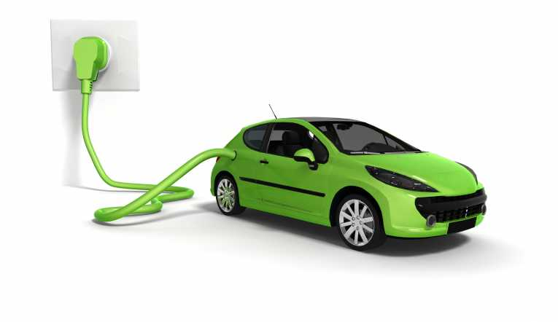

Slide 3
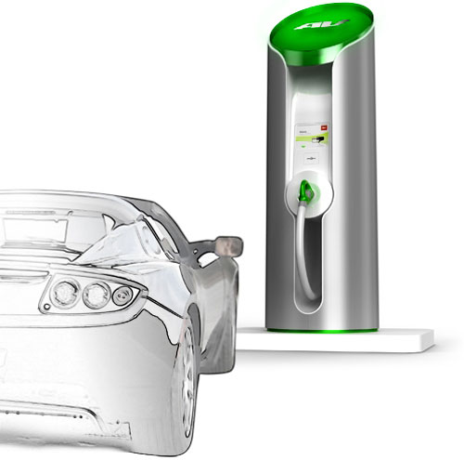
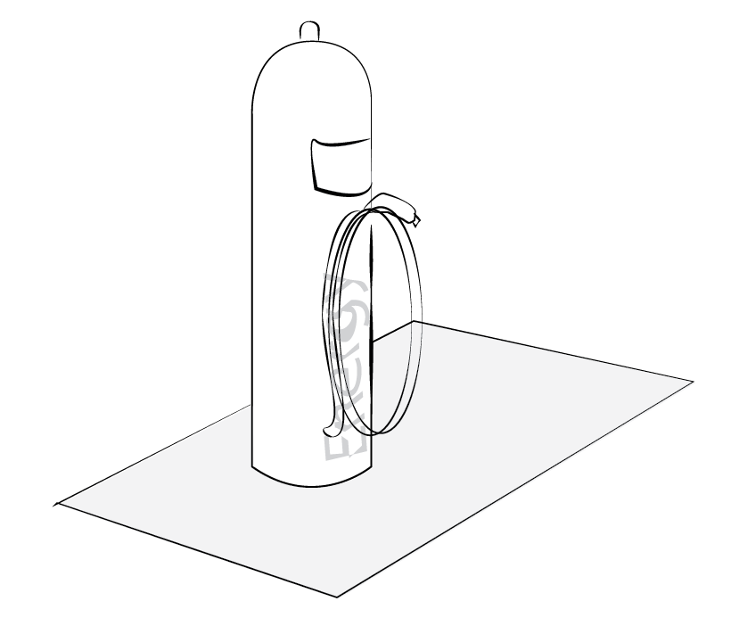
Source: http://www..clubcandoca.com.br

Slide 4
Electrical Car Charging
Connecting
The Grid
Accessibility
Environment
Energy distribution
Data Technology

Slide 5
[Our Project Model]

Slide 6
Input
Output
Participants
The team
A one semester-long course
The support from the professor, the TA, and their contacts
Architecture analysis
EV market analysis
Charging stations market analysis
Technology analysis
Regulations
Professor
Companies in the field of electric chargers, oil suppliers, electricity, individuals
Users of EV
Provide an open-sourced IAR:
Manufacturing
Suppliers
Type of contract (individuals, companies, public authorities)
Stakeholders
Substitution market
Type of infrastructure
Public policy
Current challenges
Social acceptance
Deliver a presentation of the project

Slide 7
Short-term
Medium-
term
Long-term
Get to know each other better as a team
Improved knowledge about the management of a project and useful tools
A good grade for the course
Get inspired by this market for our future career
Companies develop better strategies and decisions about this market
Help new innovative companies enter the market
Implementation of the acquired skills in internship, job and other projects
Increased feasibility, reliability of electric cars
Increased development of the electric car market and charging stations market
Better environment due to the decrease of emissions

Slide 8
[Based on the following]

Slide 9
External Factors
Assumptions
We can work correctly together
We can be interested in the subject for the semester
The resources are adequate and available
The companies know about the existence of this industrial analysis report
This industrial analysis report is relevant and useful for companies
The developments of technology in the vehicle market and their relevance, f.e.:
Hybrid technology
Electric technology
N₂ technology
Other technologies

Slide 10
[The Electric Vehicle Market]

Slide 11
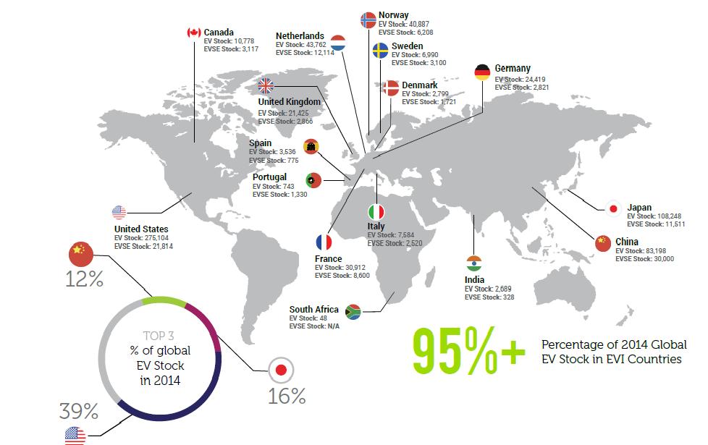
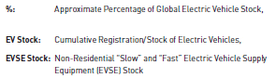

Slide 12
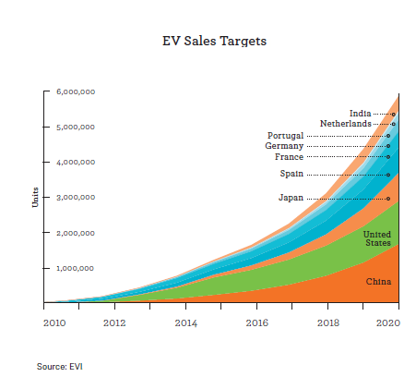

Slide 13
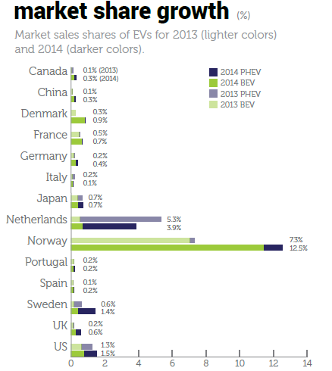

Slide 14
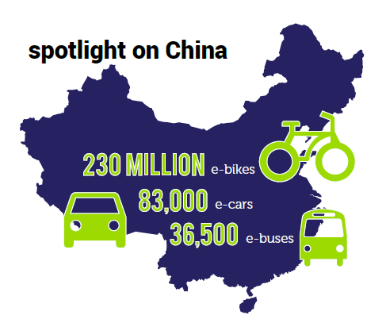

Slide 15
[The Electric Charging Market]

Slide 16
Attributes of different charging methods

Slide 17
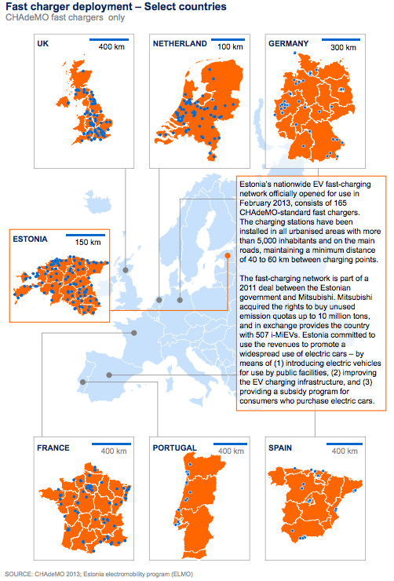
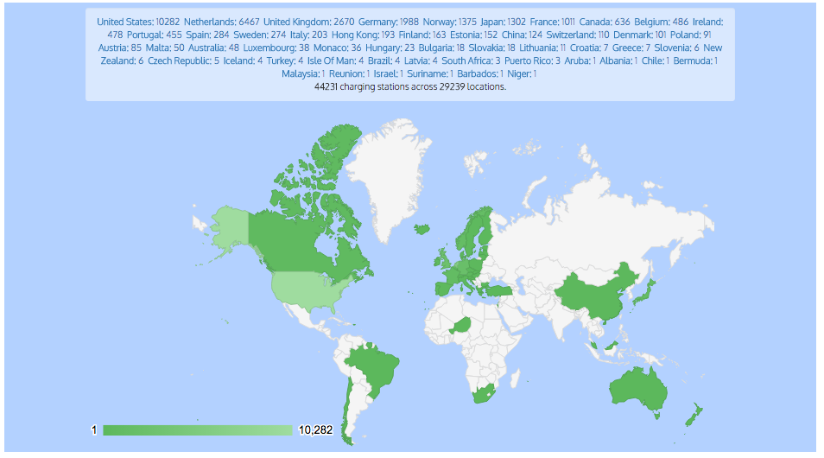
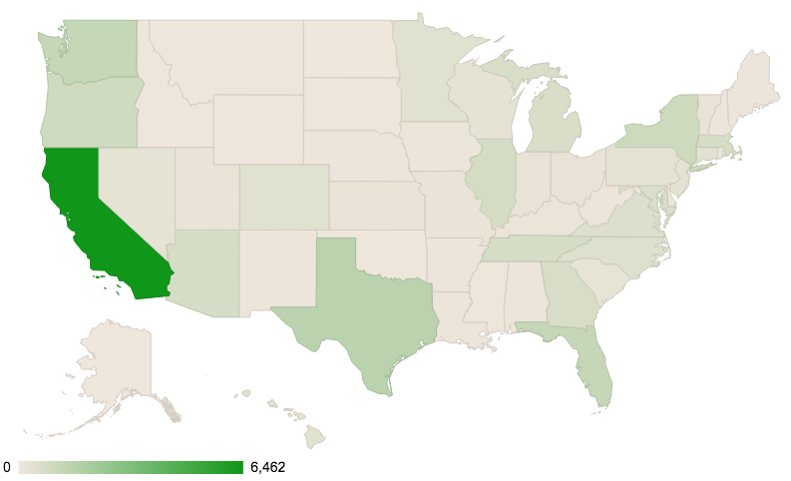

Slide 18









Slide 19






Slide 20
[Technology]

Slide 21
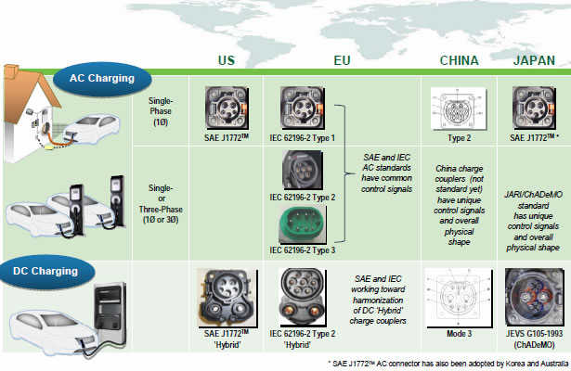
Charging time for 100 km of BEV range | Power supply | Voltage
3–4 hours | Single phase - 7 kW | 230 VAC
2–3 hours | Three phase - 10 kW | 400 VAC
1–2 hours | Three phase - 22 kW | 400 VAC
20–30 minutes | Three phase - 43 kW | 400 VAC
20–30 minutes | Direct current - 50 kW | 400 - 500 VDC
10 minutes | Direct current - 120 kW | 300 - 500 VDC

Slide 22
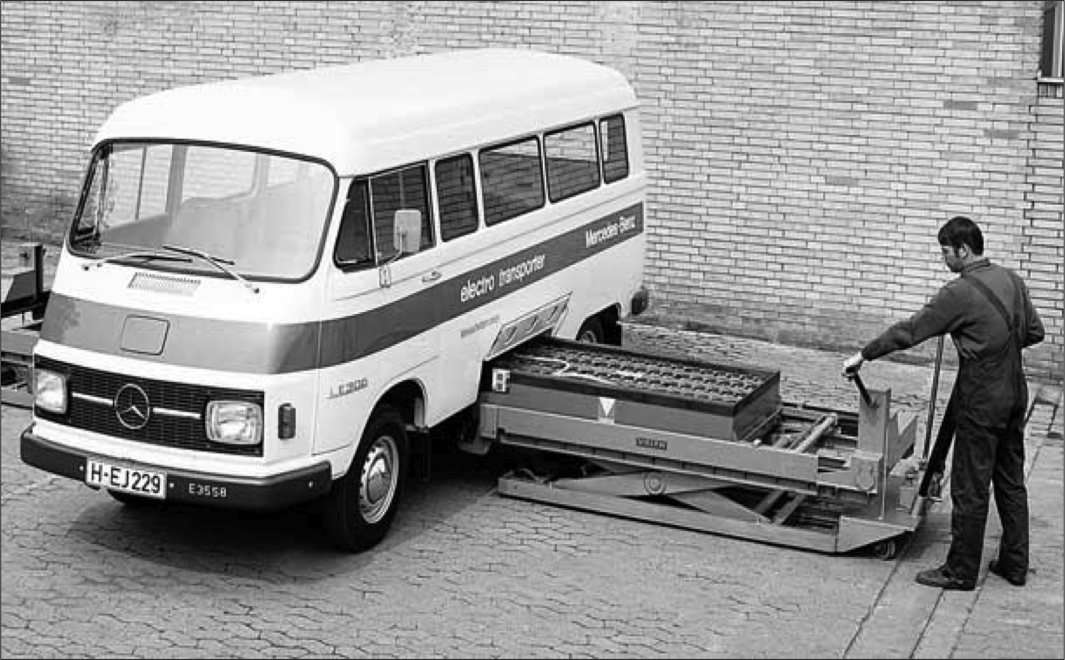
Battery swapping
Less than 5 minutes
No need to purchase a battery
Maintenance costs switch to station company
Capital costs switch to station company
Technology costs switch to station company
Battery life costs switch to station company
The spare batteries at swap stations could participate in
vehicle-to-grid storage

Slide 23
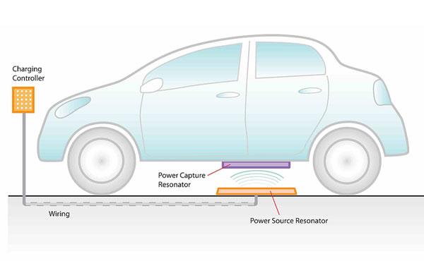
Induction charging
Safe
Flexible
Over %91 efficiency with 10’’
Unaffected up to %25 misalignment
No need to remember connecting cable
No moving parts
Waterproof
Use a bus stations (predefined routes and planned stops)

Slide 24
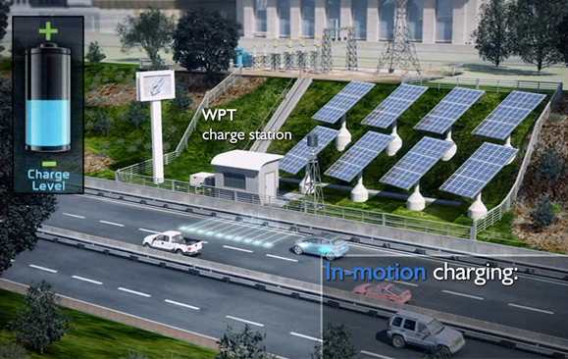
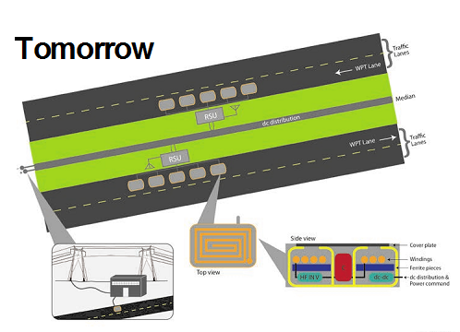
On roads (in-motion charging)
Possible for normal speed in city.
Traffic congestion allows longer charge times

Slide 25
[Architecture and zoning]

Slide 26
Parking space issues
Design of the parking spot
The current infrastructure needs to adapt (need of extra space on the front and the sides of a parking spot, electric infrastrucure on parking areas)
Possibility to have a parking spot at home (high density cities) or at work
20 million people cities ?

Slide 27
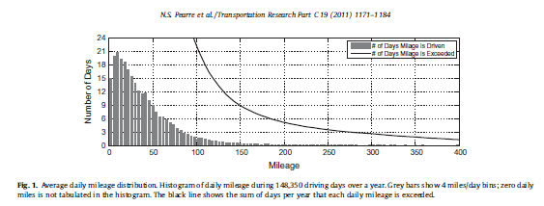
The range anxiety effect
95% Of the day’s mileage does not exceed 100 miles
Enough for EV
But fear of being out of battery very strong in the minds

Slide 28
[Laws and Regulations]

Slide 29
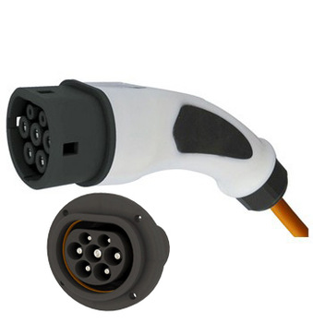
Creation of new rules and standards
→WHO?
Companies (ChargePoint, CHAdeMO)
→WHAT?
Plug in system, standardisation of the models to one model
Overview: Specific inlet/connector/plug/socket-outlet requirements, General system requirement and interface, Charging levels/Modes, Design standards …

Slide 30
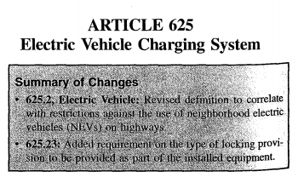
Adaptations of existing regulations
→WHO?
Governments and organizations,
f.e. International Electrotechnical
Commission, European
Environment Grenelle
→WHAT?
Creation of a section “EV charging stations” in the National
Electronic Code (NEC, US)
Overview: Rating of the supply voltage, safety standards, framework, agents, grids, metering, communication and control

Slide 31
[Next steps]

Slide 32
Questions | Indicators | Source of data
What are the best type of suppliers/partners ? (car manufacturer, web companies, electricity providers) | What are the key technologies involved ? | Open data, research Companies business model
What kind of contract should be designed ? | How many people with no garage ? How many companies can have a fleet of EV as job cars ? What’s the rate of usage of public charging stations ? How many charging stations needed per user in a city ? What are the current business models ? | Estimation estimation Open data Research paper/estimation Analysis of companies
How to deal with the substitution market ? | What are the substitution markets What are the market share of other technologies ? What is the expected year of development of the substitution technologies | Open data Open data+company analysis Research and expert review
How to overcome range anxiety ? (communication/advertsimement channel, better range for EV, dense network of charging stations) | What amount of battery used in a big city to go to the opposite point What total range to overcome range anxiety ? What impact of communication campaigns ? | Estimation Surveys and research _

Slide 33
[Thank you]

Slide 34
Leaders in Environment Analysis and Definition of Strategy

Slide 35
Input
Output
Participants
The team
A one semester-long course
The support from the professor, the TA, and their contacts
Architecture analysis
EV market analysis
Charging stations market analysis
Technology analysis
Regulations
Professor
Companies in the field of electric chargers, oil suppliers, electricity, individuals
Users of EV
Provide an open-sourced IAR:
Manufacturing
Suppliers
Type of contract (individuals, companies, public authorities)
Stakeholders
Substitution market
Type of infrastructure
Public policy
Current challenges
Social acceptance
Deliver a presentation of the project

Slide 36
Short-term
Medium-
term
Long-term
Get to know each other better as a team
Improved knowledge about the management of a project and useful tools
A good grade for the course
Get inspired by this market for our future career
Companies develop better strategies and decisions about this market
Help new innovative companies enter the market
Implementation of the acquired skills in internship, job and other projects
Increased feasibility, reliability of electric cars
Increased development of the electric car market and charging stations market
Better environment due to the decrease of emissions

Slide 37
[Based on the following]

Slide 38
External Factors
Assumptions
We can work correctly together
We can be interested in the subject for the semester
The resources are adequate and available
The companies know about the existence of this industrial analysis report
This industrial analysis report is relevant and useful for companies
The developments of technology in the vehicle market and their relevance, f.e.:
Hybrid technology
Electric technology
N₂ technology
Other technologies

Slide 39
Questions | Indicators | Source of data
What are the best type of suppliers/partners ? (car manufacturer, web companies, electricity providers) | What are the key technologies involved ? | Open data, research Companies business model
What kind of contract should be designed ? | How many people with no garage ? How many companies can have a fleet of EV as job cars ? What’s the rate of usage of public charging stations ? How many charging stations needed per user in a city ? What are the current business models ? | Estimation estimation Open data Research paper/estimation Analysis of companies
How to deal with the substitution market ? | What are the substitution markets What are the market share of other technologies ? What is the expected year of development of the substitution technologies | Open data Open data+company analysis Research and expert review
How to overcome range anxiety ? (communication/advertsimement channel, better range for EV, dense network of charging stations) | What amount of battery used in a big city to go to the opposite point What total range to overcome range anxiety ? What impact of communication campaigns ? | Estimation Surveys and research _

